Slide 1

Family Dental Care and RCT Center
Sugam Shrestha

Slide 2
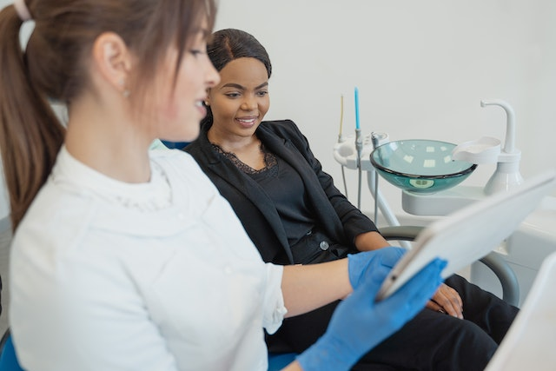
Objectives
To be familiar with HTML and CSS
To use HTML tags and attributes to create a webpages
To apply CSS to design webpages efficiently
To be able to create the responsive and professional-looking websites

Slide 3
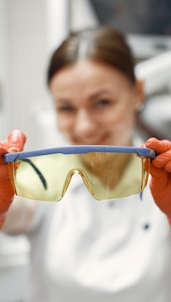
Introduction
Our website (Family Dental Care and RCT Center) is designed with the user-friendly and informative platform for patients to learn about our services and book an appointment.
Our goal is to provide the online presence to the patients and to reach in a wider audiences.

Slide 4
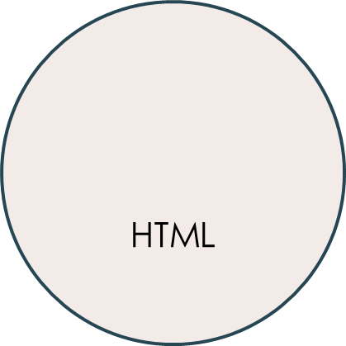
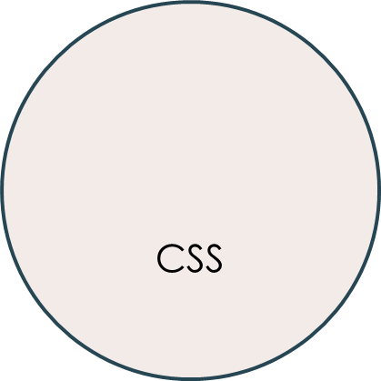


Technology used

Slide 5
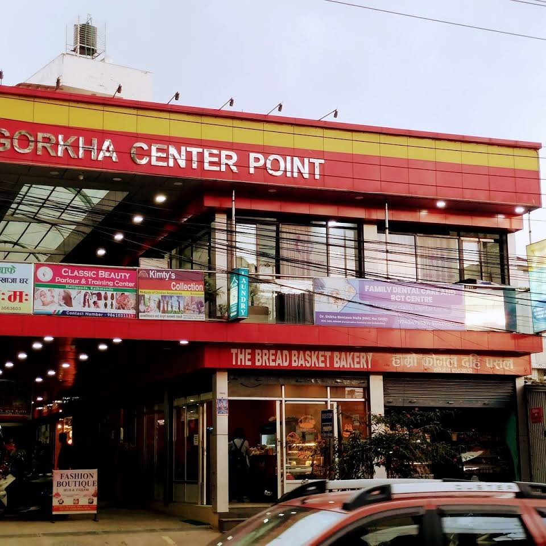
Preview

Slide 6





Future Enhancement
Virtual consultants
Easily connect with their dentist
Personalized dental care
Implementing personalized dental care plans
Design
Color psychology
Online payment
Manages dental expenses
Dental education
Provide dental education and resources

Slide 7
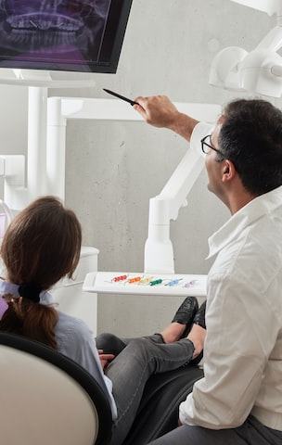
Summary
I learn the fundamental skills and concepts required to build, style, and publish functional and visually appealing websites using HTML and CSS.

Slide 8
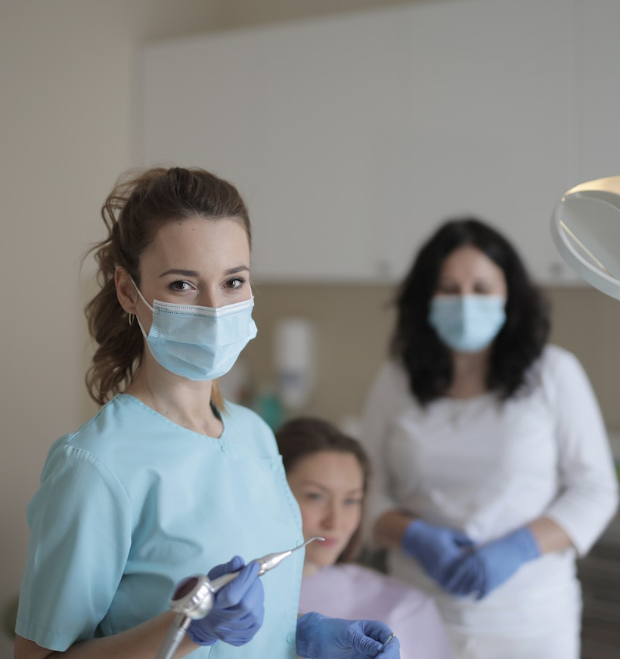
Thank you
Sugam Shrestha

